Slide 1
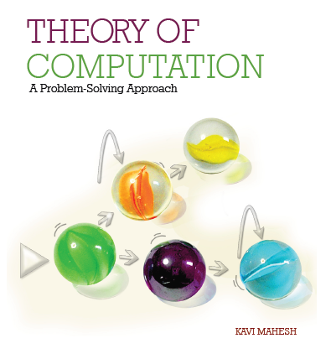

Theory of Computation: A Problem-Solving Approach
Chapter – 8: Pushdown Automata

Slide 2
Learning Objectives
Learn how to add memory to a finite automaton.
Learn the equivalence of stack memory and context-free behavior.
Learn to construct a pushdown automaton for a context-free language.
Learn to convert a context-free grammar to a pushdown automaton.
Learn to convert a pushdown automaton to a context-free grammar.
Understand why non-determinism is required in pushdown automata.

Slide 3
Machines for Context-Free Languages
Add memory to a finite automaton in the form of a stack
Unlimited size
Machine can store symbols by pushing them onto the stack
It can pop stored symbols from the stack and match them to later symbols in the input
It can count
No random access to memory; only top of the stack is accessible
Stack behavior is equivalent to context-free behavior

Slide 4
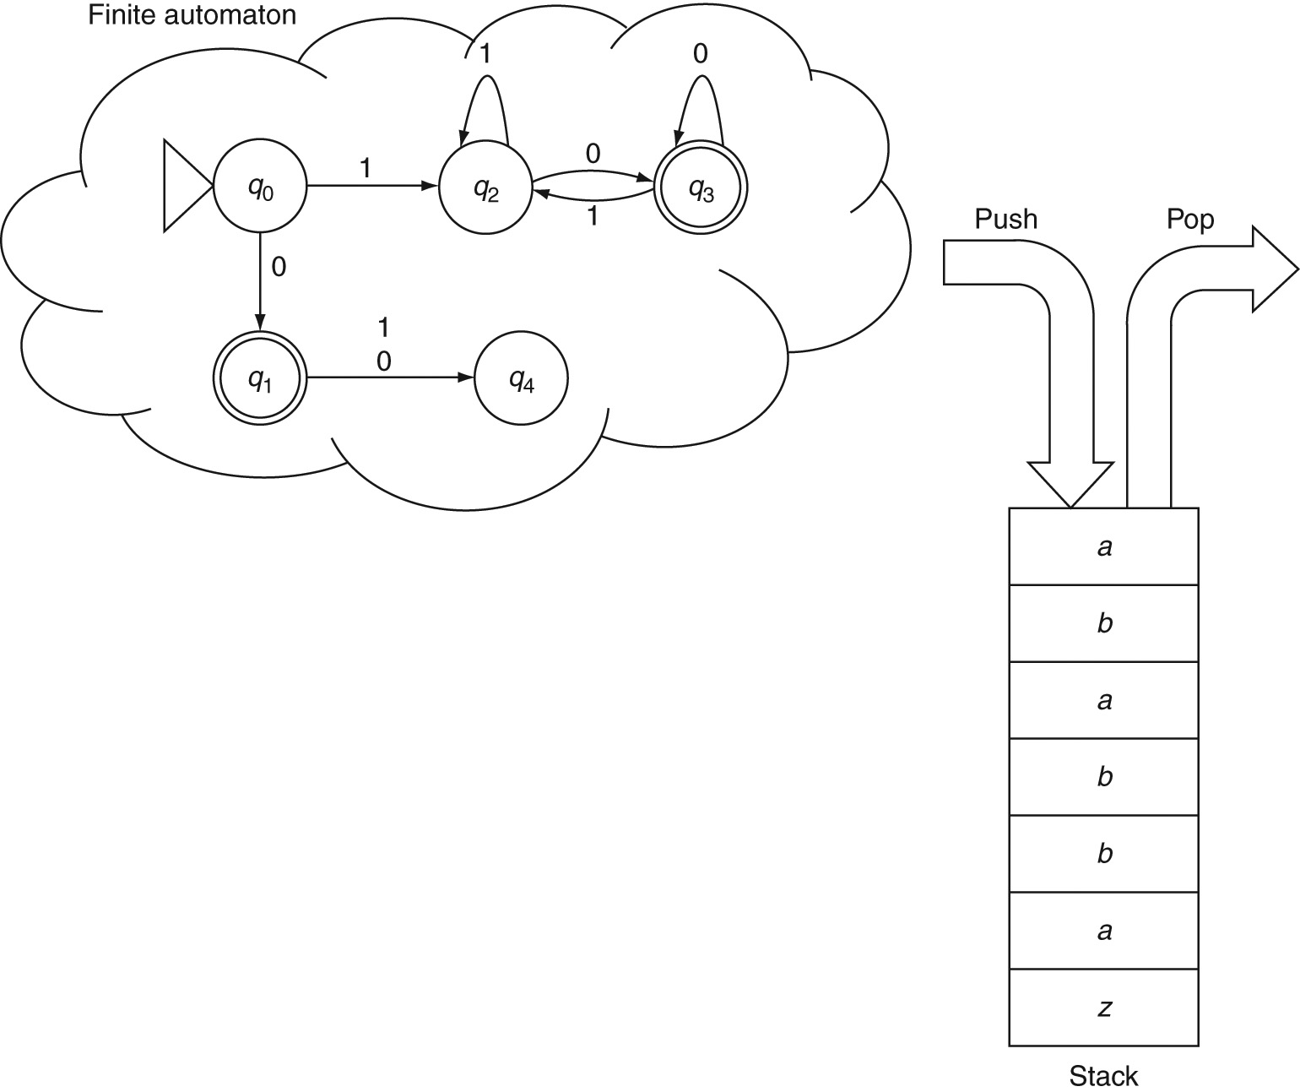
Pushdown Automaton

Slide 5
Elements of a Pushdown Automaton
A pushdown-automaton (PDA) M has 7 elements:
M.alphabet: Denoted by Σ, the input alphabet is the set of symbols present in input strings.
M.stackAlphabet: Denoted by Τ, the stack alphabet is the set of symbols used for storing on the stack. This set may or may not be the same as the input alphabet.
M.states: Also denoted by Q, it is the finite set of all states in the automaton.
M.startState: Usually denoted by q₀, it is the start state of the automaton.
M.finalStates: Denoted by Q_{F}, it is the subset of M.states that are final or accepting states of the automaton.
M.transitionFunction: This is a function δ from Q X Σ X Τ to Q X (POP) X (Τ), that is, a mapping from the current state, the current input symbol and the current symbol at the top of the stack, to a new state, an optional pop operation on the stack and a stack symbol that is optionally pushed onto the stack.
M.bottomOfStack: Usually denoted by z, it is a special symbol that is assumed to be always present at the bottom of the stack.

Slide 6
Operations of a PDA
Start with q₀ as the current state and z as the only symbol on the stack.
Examine the next input symbol reading it from left-to-right in a single pass. Examine the current symbol at the top of the stack.
Based on the input symbol, the current state and the stack symbol, find one or more matching transitions.
Execute the transition by:
consuming the input symbol,
moving to the new state as specified by the transition function,
popping the symbol on the top of the stack if so specified by the transition function and
pushing the symbol specified in the transition (if any) onto the stack.

Slide 7
Language of a PDA
When the input symbols are exhausted, if the machine is in a final state and if the stack is empty (i.e., if the symbol at the top of the stack is z), then we say the machine has accepted the input string. Otherwise, the machine rejects the input string.
The set of all strings over the alphabet that a PDA accepts is called the language of the machine (denoted by M.language).
The snapshot or instantaneous description or configuration of a PDA at a particular step during a computation can be captured by including the contents of its stack, the current state of the automaton, and the remaining part of the input string. For example the configuration
(q₃, abb, ABB)
means that the current state is q₃, input symbols remaining to be processed are abb and the current stack contents are ABB, A being the symbol on the top of the stack. Based on our convention, it is understood that the bottom-of-stack symbol z is present below these three stack symbols.

Slide 8
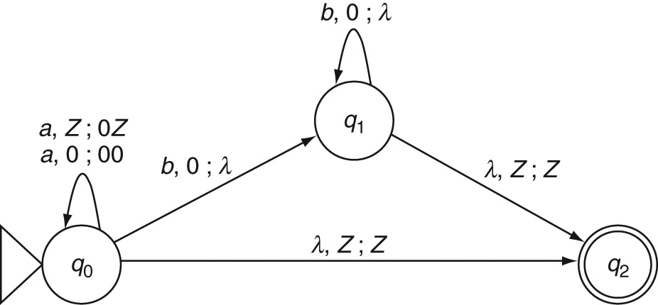
Constructing a PDA: Example 8.1
The language of simple nesting or a^{n}b^{n}

Slide 9
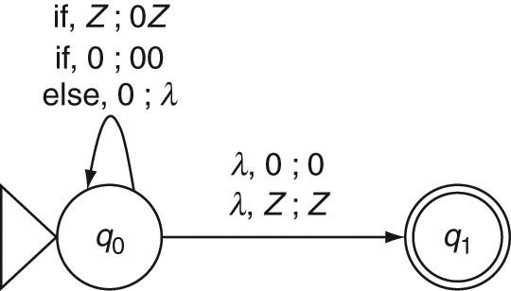
Constructing a PDA: Example 8.2
Nested if-else statements

Slide 10
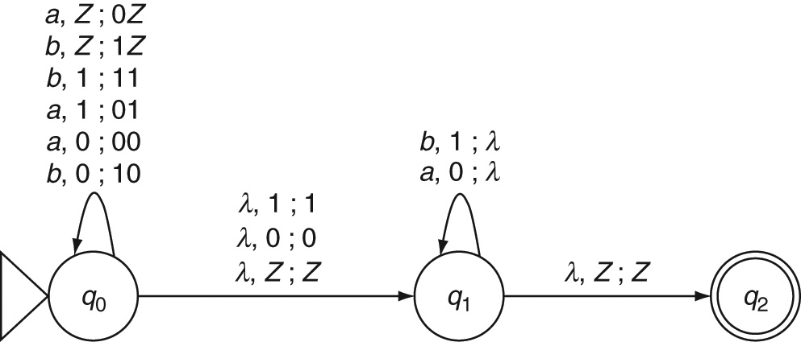
Constructing a PDA: Example 8.3
Non-deterministic PDA for even palindromes

Slide 11
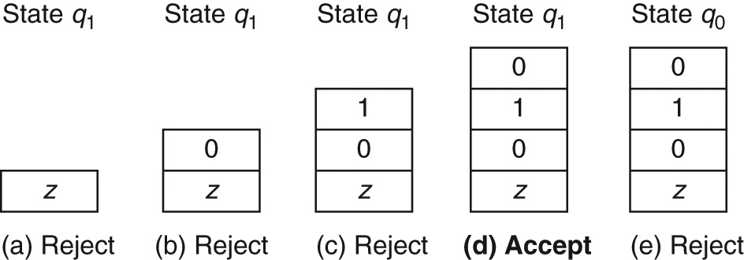
Example 8.3: Stack Contents
Possible configurations after processing aba in the input abaaba

Slide 12
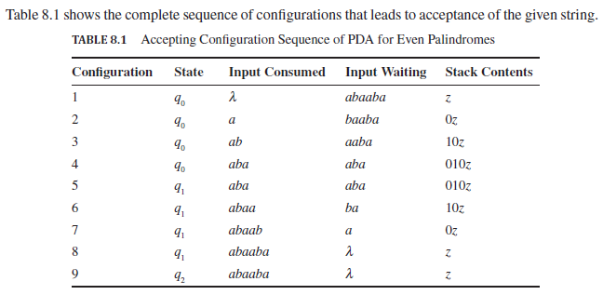
Example 8.3: Accepting Configuration

Slide 13
Mantras for Constructing PDAs
What is a context-free grammar for the language?
What parts of strings in the language are correlated?
When do we introduce a new state?
How is it different from known languages?
Are any parts of strings in the language regular?
Do we need non-determinism?

Slide 14
Mantras for PDAs (contd..)
All the other mantras that we have been using from Chapter 2 are useful in constructing PDAs as well:
What is the simplest string in the language?
Is the null string a member of the language?
What are the patterns at the beginnings and ends of strings in the language?
What does the machine need to remember (through states and through the stack, in the case of a PDA)?
Do we have all the possible transitions from all the states for all the inputs symbols?
What is the complement of the language? What does the machine need to reject?
Do we need an explicit reject state?
Is the language the union of multiple sub-languages so that they can be handled in parallel branches?

Slide 15
Converting CFG to PDA
Convert the given CFG to Greibach Normal Form.
From the start state q₀ of the PDA,
(a) Add a transition to a new state q1 with the label (λ, Z; SZ).
3. For each production rule of the form T  aUXYZ…
(a) Add a transition from q1 to q1 with the label (a, T; UXYZ…)
4. From state q1, add a transition to a new final state q2 with the label (λ, Z; Z).

Slide 16
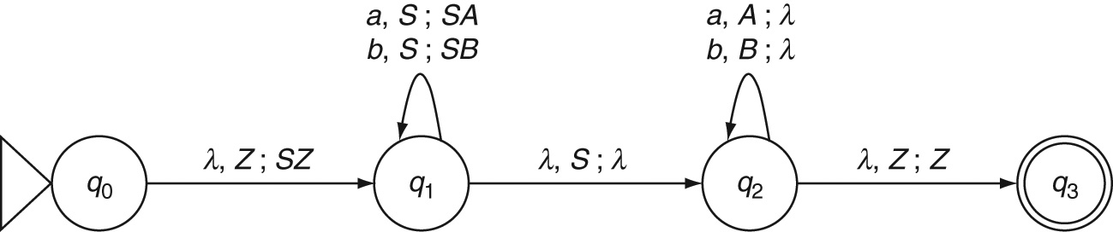
CFG to PDA: Example 8.4
Even palindromes
Grammar: S → aSa | bSb | λ
Greibach Normal Form
S → aSA | bSB | λ
A → a
B → b

Slide 17
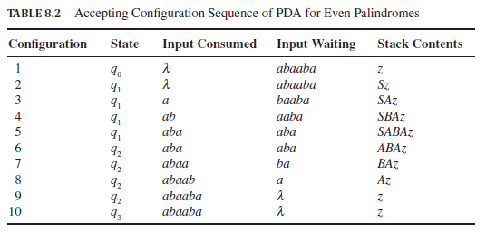
Example 8.4: Accepting Configuration

Slide 18
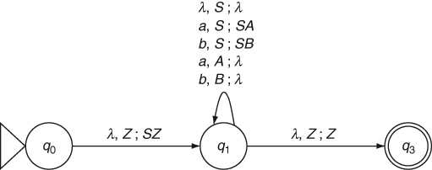
Another PDA for Example 8.4

Slide 19
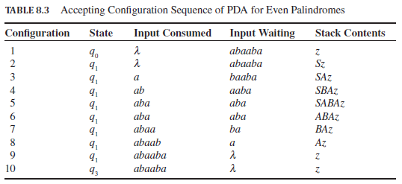
Another Accepting Sequence: Example 8.4

Slide 20
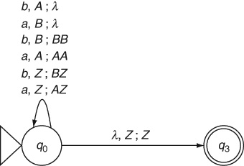
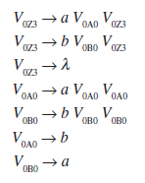

Converting PDA to CFG: Example 8.5
Equal numbers of a and b
CFG

Slide 21
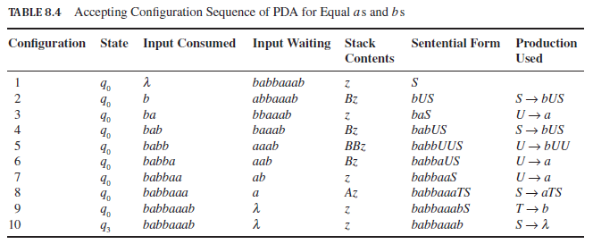
Example 8.5: Accepting Configuration

Slide 22
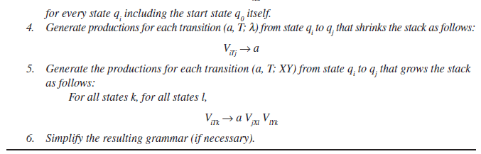
PDA to CFG: Algorithm
Algorithm
Redesign the PDA so that every transition either pops one symbol from the stack (shrinks by 1) or replaces the symbol on the top of the stack with two symbols (i.e., grows the stack by 1).
Generate the list of variables by enumerating all the triples of a state, another state reachable from the state and a stack symbol.
Generating productions for the start symbol S as follows:
SV_{0zi}
For every state qi including the start state q₀ itself.
4. Generate productions for each transition (a, T;

Slide 23
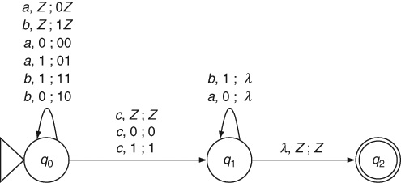
Deterministic PDA: Example 8.6
The language of odd palindromes, wcw^{R}

Slide 24
Theorems
Theorem 15: Equivalence of Nondeterministic PDA and CFL: The language of every nondeterministic pushdown automaton is a context-free language. Conversely, for every CFL, there is an equivalent NPDA that accepts the language.

Slide 25
Key Ideas
A memory unit is added to a finite automaton to overcome its limitations of not being able to count or remember a sequence of input symbols.
Adding a memory unit that behaves like a stack data structure to a finite automaton gives us a pushdown automaton.
The stack memory is supposed to be of unlimited size although the number of states in the pushdown automaton must still be finite. There is no reason to limit the memory size of a PDA and thereby eliminate some input strings from being accepted.
The language of a pushdown automaton is a context-free language.
Context-free languages require the PDA to be non-deterministic. A deterministic PDA cannot handle languages such as even palindromes that require guessing the midpoint of the input string non-deterministically.
Context-free grammars and pushdown automata are equivalent.

Slide 26
Key Ideas (contd..)
A grammar in Greibach Normal Form can be used to convert it to an equivalent pushdown automaton. The terminal symbol in the production rule matches the next input symbol and the non-terminal symbol on the left-hand side of the production is popped off the stack to be replaced by the non-terminals on the right-hand side.
A pushdown automaton can be converted to an equivalent context-free grammar although the resulting grammar is often unreadable.
Deterministic pushdown automata can only handle deterministic context-free languages which are a proper subset of context-free languages.
Although there is no algorithm to design a pushdown automaton, the set of mantras discussed in this chapter help us in designing an accurate PDA for a given problem.

Slide 27
End of Chapter 8

